Slide 1


Powerlearn project- Final Project Presentation
30.03.2023
Notes:
Recommending picking out he most interesting and important parts from your documentation.

Slide 2
Crop Leaf Disease Detection
Nyingi Joseph

Slide 3

Background
Data Scientist - Machine Learning Engineer

Slide 4
Outline
Problem statement
Current solution
Proposed solution
Dataset
Data preparation - Augmentation
Models - your solutions
Outputs - artifacts - Evaluation

Slide 5
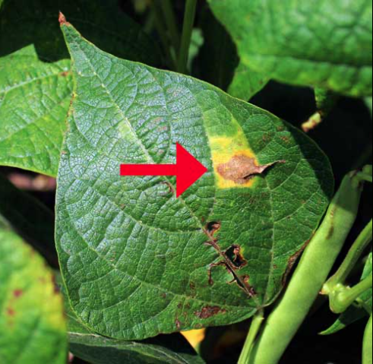
Problem statement
Crops’ production and quality are heavily affected by diseases.
Which cause adverse impacts on food security as well as economic losses

Slide 6
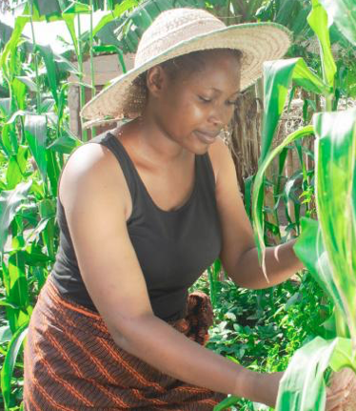
Current solution
Farmer visually inspecting diseases on the crops

Slide 7
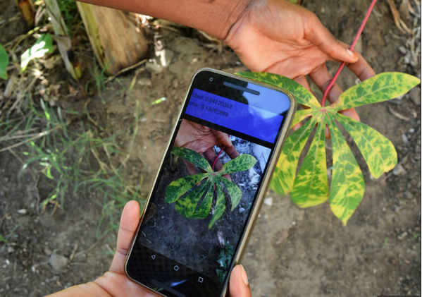
Proposed solution
Use of image recognition

Slide 8
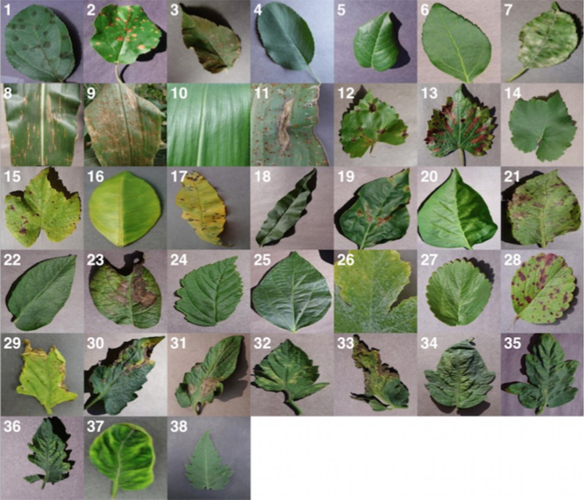
Dataset
54,305 images

Slide 9
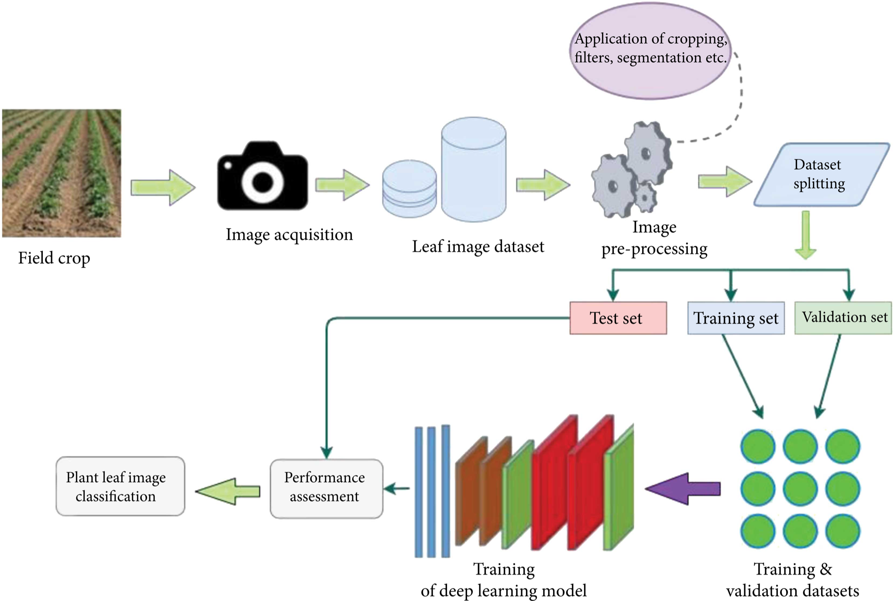
Computer vision-based approach to plant disease detection and classification

Slide 10
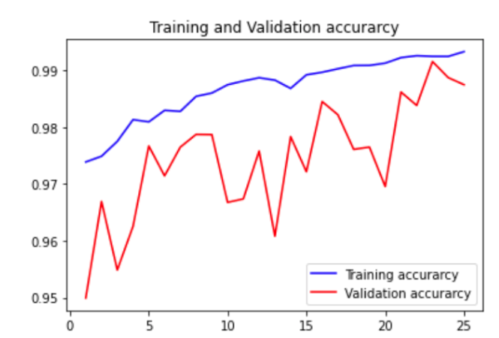
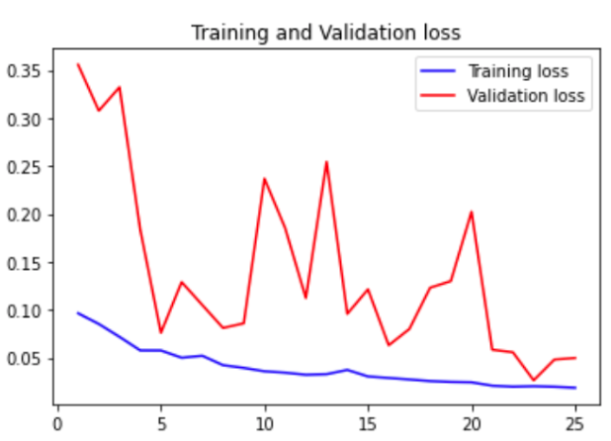
Output - Evaluation
Training accuracy increases, validation accuracy increases
Training loss decreases, the validation loss decreases too

Slide 11
cont.
Model achieved test accuracy of 98.75%!!

Slide 12
Reference
Github link is Here

Slide 13
Thank you

